Slide 1
Build a minimal bootable Linux distro for .NET environment
Kenji Mouri (Qi Lu)
Kenji.Mouri@Outlook.com
December 24, 2023

Slide 2
Design Goal
Just for fun is the most important.
Help .NET developers to build a small image for deployment in their containers, virtual machines and IoT devices.
The first stage of helping me achieve the goal of porting full .NET CoreCLR experience to UEFI.
Prove potential for system programming with C#.
Just getting the experience for making customize Linux.

Slide 3
Presentation

Slide 4
Architecture
This architecture is for this presentation only.
This presentation integrates the full .NET Runtime with full i18n support.
The root file system of this presentation is NTFS.
This presentation typically needs 192MB memory and 256MB storage.
MinCLR (.NET/Linux)
PowerShell
SimpleWebServer
.NET Runtime
MinLin (Minimum Linux)
Minimum Native Infrastructure
Hyper-V/NanaBox optimized Linux Kernel

Slide 5
What’s MinLin?
MinLin is an abbreviation of Minimum Linux.
MinLin is a research project for helping me design a non-POSIX OS kernel with Linux support.
MinLin is hypervisor friendly because para-virtualization is a satisfactory solution for wrapping Linux to non-POSIX environments for bring more flexibility in non-POSIX OS kernel designs.
The reference para-virtualization platform for MinLin is Hyper-V.

Slide 6
Why reference platform is Hyper-V?
Hyper-V is a validated popular para-virtualization platform via history.
Its aggressive para-virtualization design can help implement smaller bootable Linux instances.
GPU-PV can help implement out-of-box ROS robots and self-driving car development environments.
NanaBox is a third-party Hyper-V virtualization client based on Host Compute System API.
Salute to Microsoft MinWin demo at PDC 2009.

Slide 7
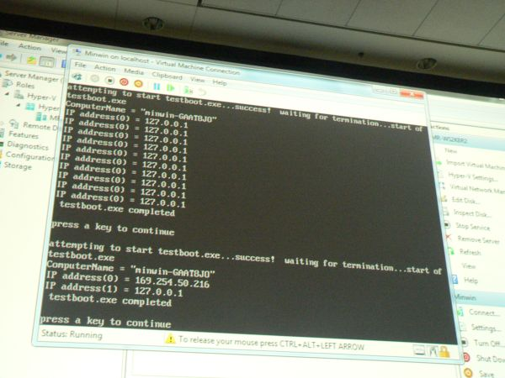
Microsoft MinWin demo at PDC 2009

Slide 8
What’s MinCLR?
It’s originally a project created in 2020 with the goal of porting CoreCLR to UEFI when I was just graduated.
.NET/Linux is the first stage of the MinCLR project.
Originally, the second stage is planning to port CoreCLR to NuttX and NuttX to UEFI, and replacing the NuttX with UEFI support to a minimum runtime for the third stage. But I think NuttX is too complex and not friendly for MSVC toolchain. So, that two stages are merged to the new second stage called creating Linux user space emulator for UEFI.

Slide 9
Related roadmap for the future
Making optimized Linux Kernel for KVM/QEMU, VMware ESXi and Raspberry Pi if people interested and hope me to do.
Making root file system by compiling upstream sources instead of using binaries from Alpine.
Make LVGL for .NET interoperability libraries.
Try to create a Wayland compositor with 100% .NET for better quality and maintenance via standing on the shoulders of giants.

Slide 10
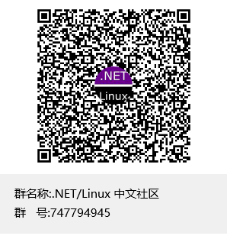
Thank you
For more information, there are several ways available.
Source code available at https://github.com/SherryPlatform.
Documentation available at https://github.com/SherryPlatform/MinCLR/blob/main/Platform/Linux/ReadMe.md
Join QQ group 747794945 or scan the right QR code.

